Slide 1

ByteDance Business Analysis Assignment
Presented by Marcus Li

Slide 2
Section 1: Dashboard Overview

Slide 3
My Assumptions
Reservation accounts will guarantee you the volume that you have paid for. This type of account comes at a higher cost as you will have to commit to flat-rate pricing which will give you less flexibility. Type of account will let you advertise with unique campaign types.
Auction accounts are more flexible and unlike Reservation Accounts, there aren’t any flat rates to be paid. Pricing will be based on a mix of bids and competition. With this type of account, you will only be able to have In-Feed ad.
In Salesforce, an opportunity is a sale or pending deal. Multiple opportunities make up your sales pipeline, which contributes to your sales forecast.

Slide 4
Dashboard Overview
Helps sales team track Revenue targets % achieved
Quick overview of Revenue & opportunities achieved by teams/salespersons
Identify opportunity values by industry and by advertising clients
Saves time on analysis by automating report

Slide 5
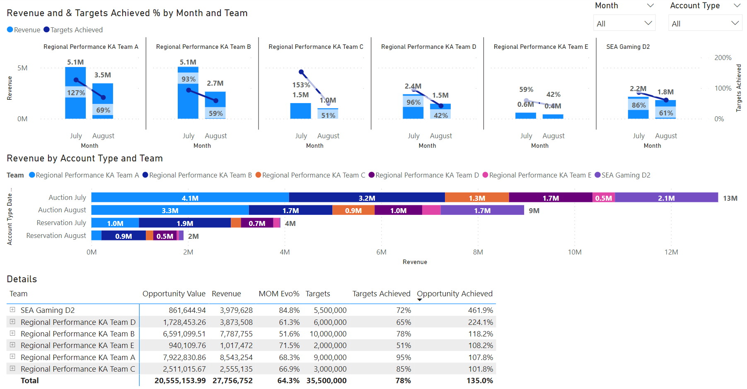
Revenue Page
Filter by month and account type. If no filter, dashboard shows YTD
Graphical view of revenue achieved by team & target % reached
Breakdown by account type & team
Opportunity achieved & MOM Evo% can only be seen when view of 1 month is selected

Slide 6
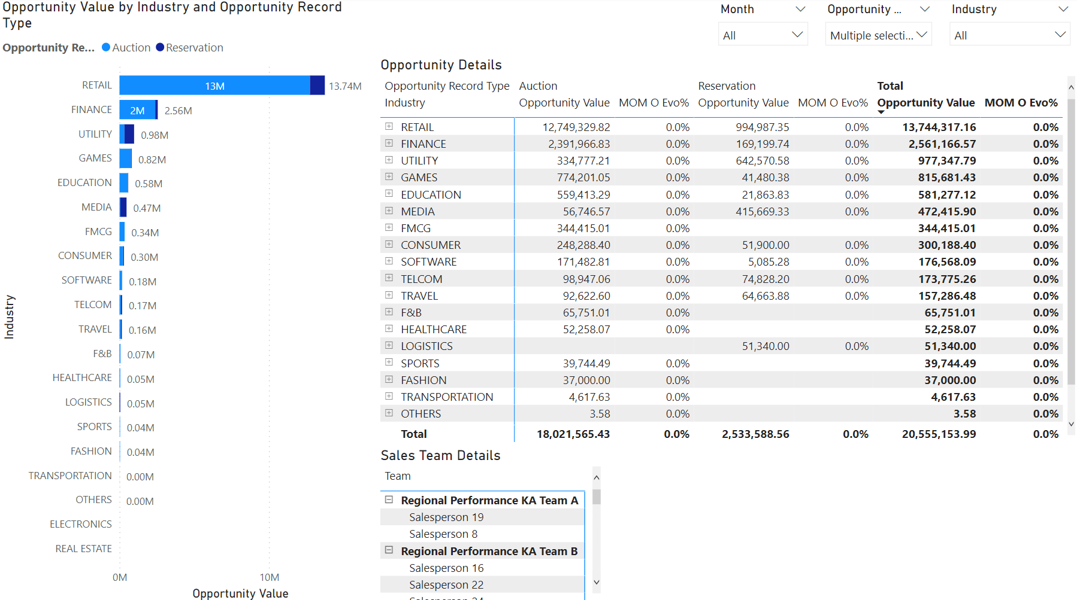
Opportunities by Industry Page
Filter by month, account type and industries. If no filter, dashboard shows YTD
Graphical view of opportunities by industries with separation of account types
MOM evo% can only be seen when view of 1 month is selected
View of salespersons. Will be filtered if user selects any industry in the above 2 graphs. Good to see quickly which salespersons have those industries in their accounts

Slide 7
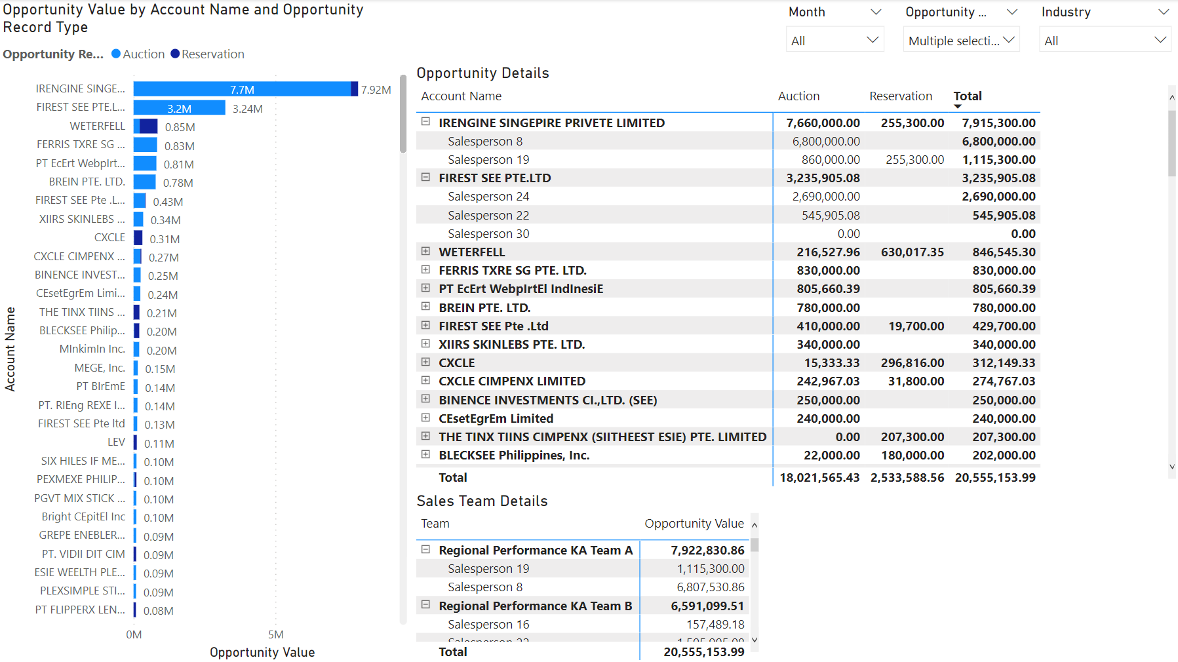
Opportunities by Accounts Page
Filter by month, account type and industries. If no filter, dashboard shows YTD
Graphical view of opportunities by Account names with separation of account types
View of salespersons. Will be filtered if user selects any industry in the above 2 graphs. Good to see quickly which salespersons have those industries in their accounts

Slide 8
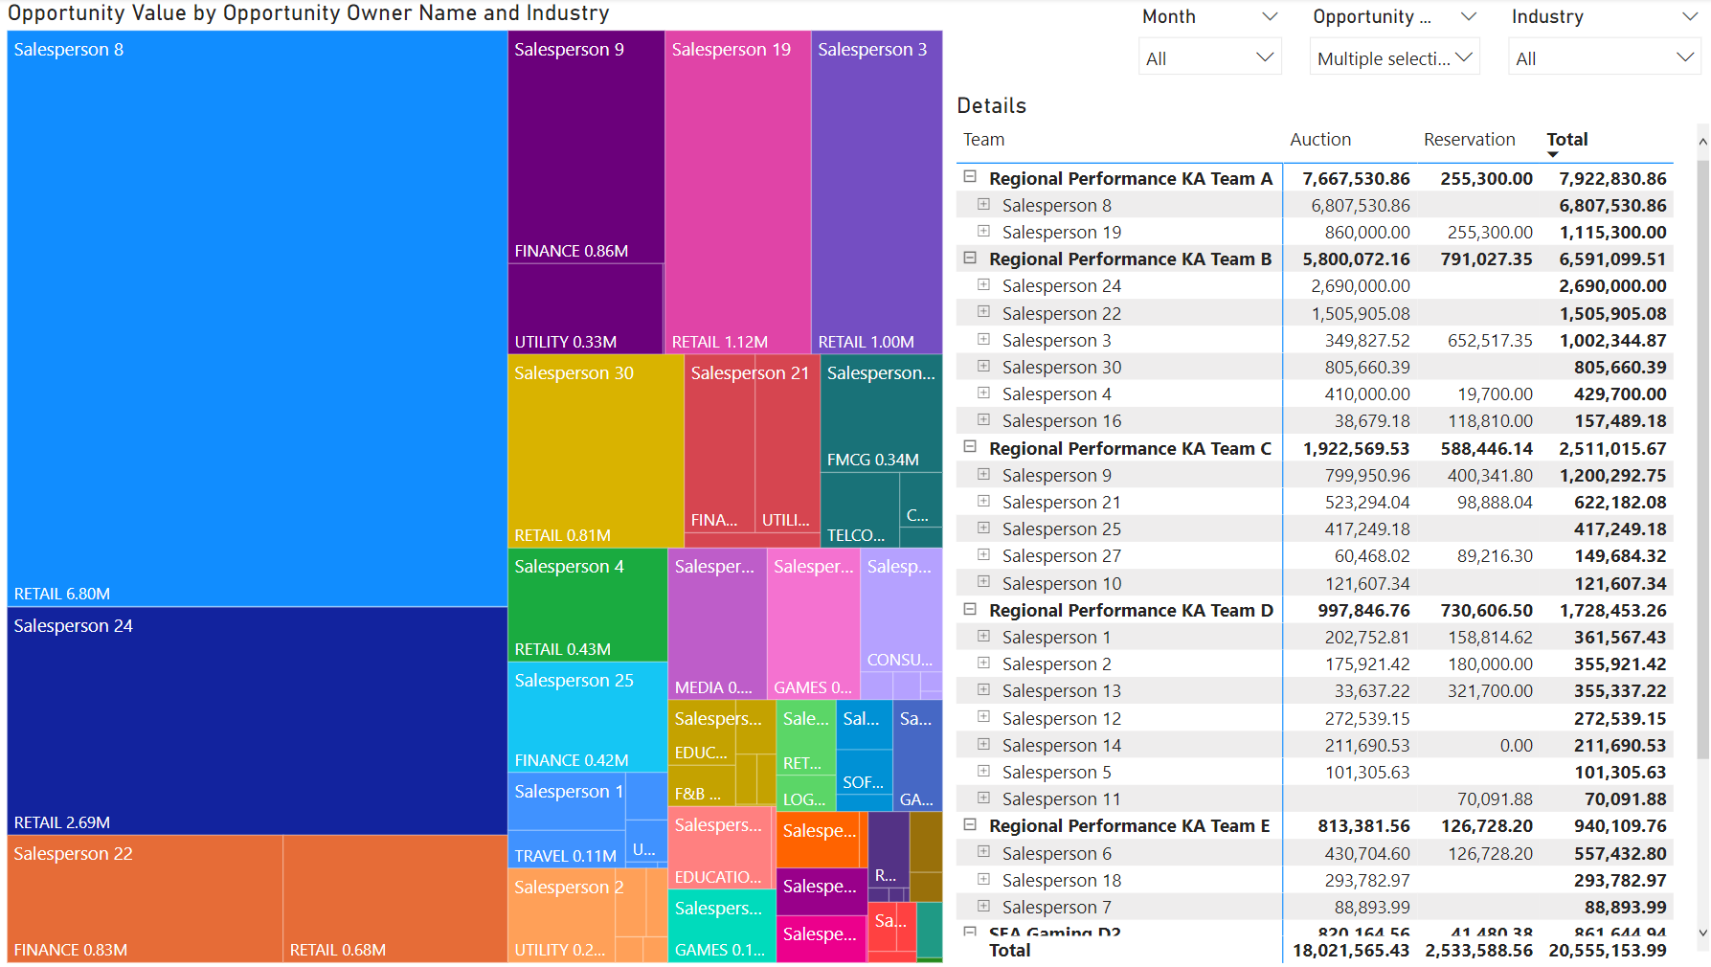
Sales Team Page
Filter by month, account type and industries. If no filter, dashboard shows YTD
Graphical view of opportunities values by salesperson with separation by industries
Detailed view of salesperson’s opportunity by accounts type

Slide 9
Section 2: Data Analysis

Slide 10
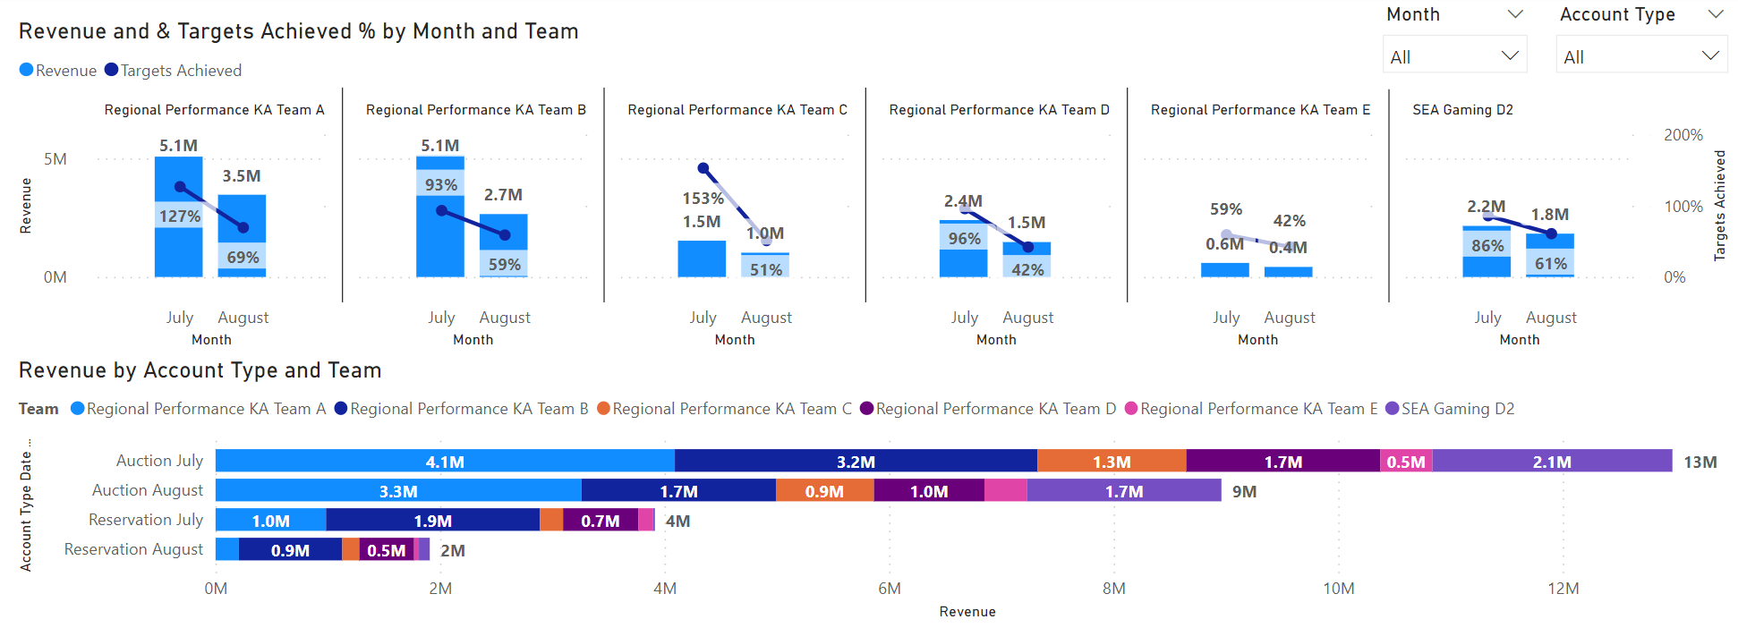
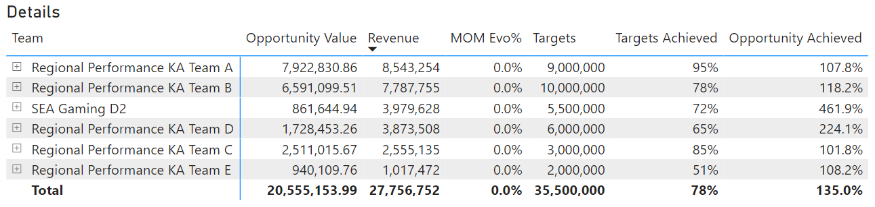
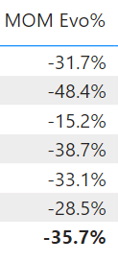
Revenue Analysis
Total bi-m revenue 27.7M
-35% evo from July to Aug
78% targets achieved
Team A & C performed best
Team E & D performed least
All teams saw slumps in August but Team E was underperforming for both months
Teams D2 & D hit 460% and 224% respectively from their opportunities.
5M out of 27.7M came from Reservation.
Bi-m Sales targets for Reservation only hit 16%
Aug

Slide 11
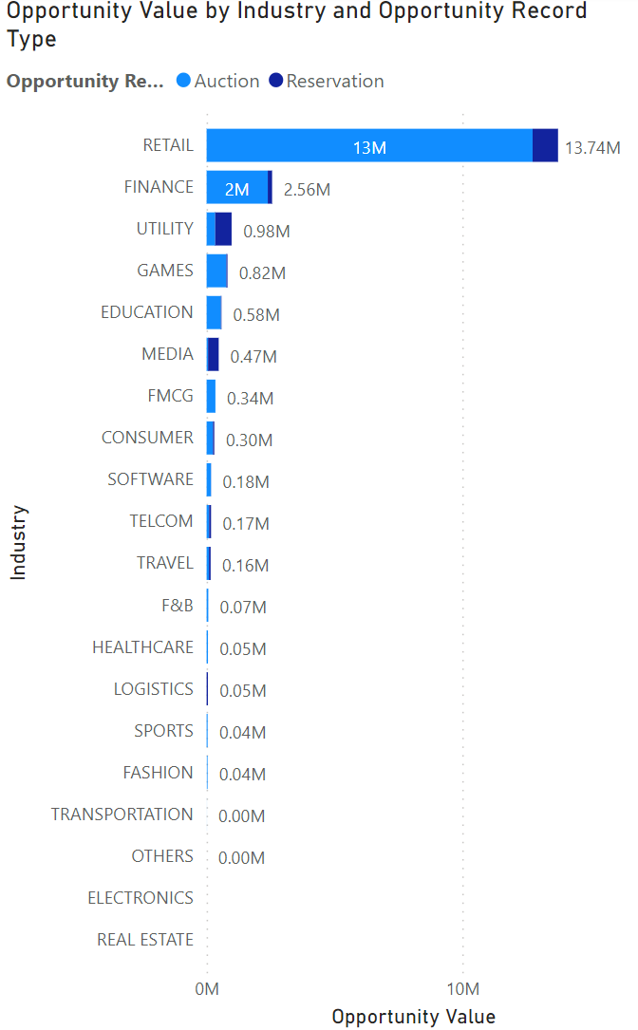
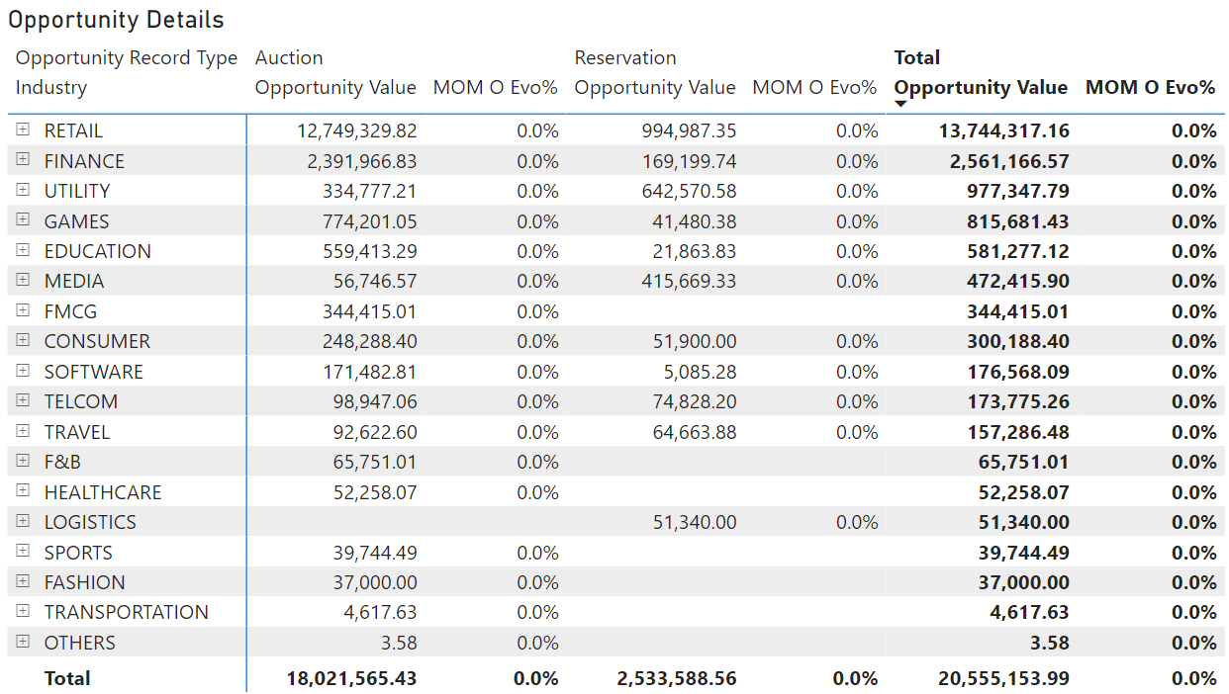
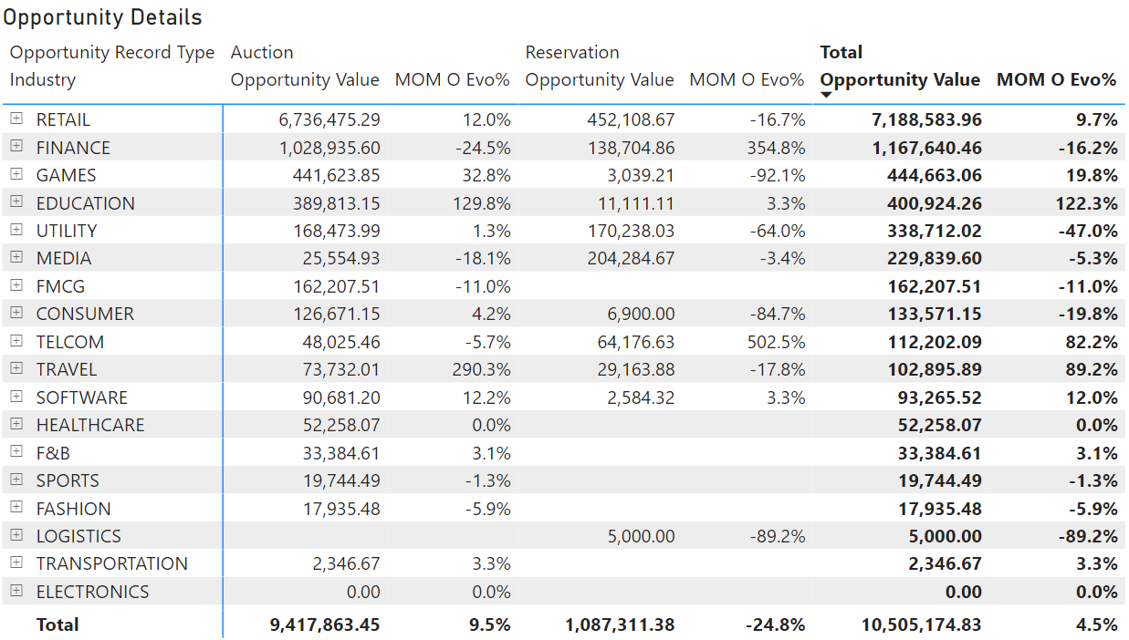
Opportunities Analysis
Bi-m opportunity value of 20.5M
For bi-m, 80% of our opportunities come from Retail, Finance & Utilities
Industries which have broader target markets like media, utilities, telecom, travel & logistics have higher Reservation value. Possible due to their wider range of target market
We see huge changes in Mom Evo% of opportunity value in:
Increase: Education, Telcom, Travel
Decrease: Logistics, Utilities

Slide 12
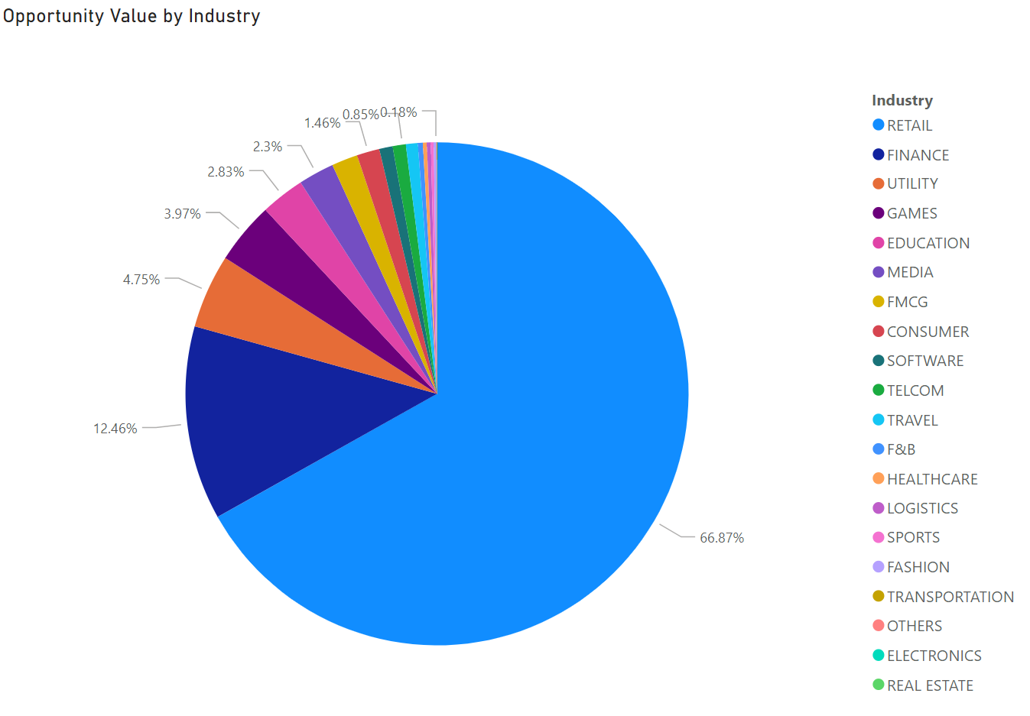
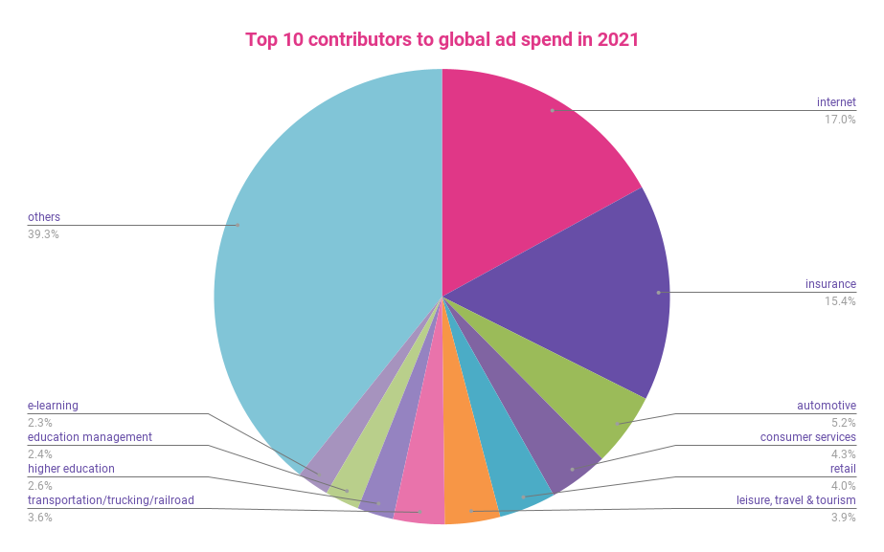
Opportunities Analysis
Comparing global ad spends with Tiktok ad spends, we can see that there is a discrepancy between where the spends are in the world vs on tiktok.
Top 10 in Tiktok are:
Retail
Finance
Utility
Games
Education
Media
FMCG
Consumer
Software
Telcom
Top 10 globally are:
Internet providers
Insurance
Automotive
Consumer services
Retail
Leisure, tourism, and travel
Transportation
Higher education
Education management
E-learning
Graphic source: https://improvado.io/blog/ads-spend-report-by-industry

Slide 13
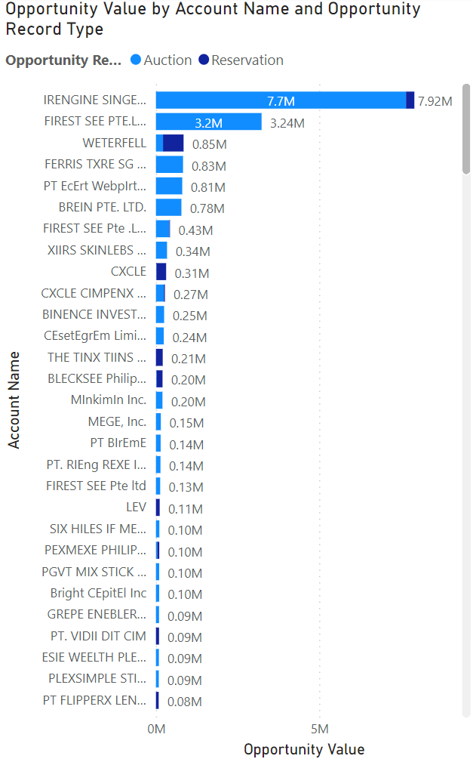
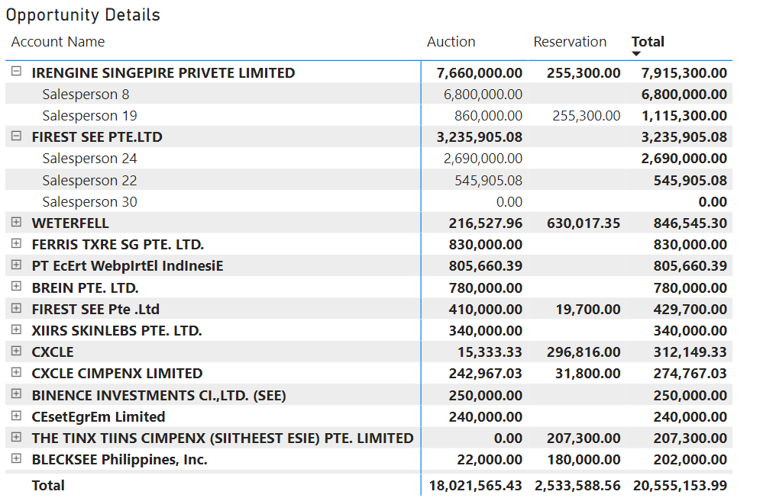
Opportunities Analysis
Half of opportunity value comes from Irengine Singepire & Firest See, with salesperson 8 & 24 managing the most of it.
Some companies prefer reservation ads more such as Weterfell, Cxcle, The Tin Tinns, Blecksee Philipippines.
There are some salespersons who do not have any opportunity value in some accounts like Salesperson 30. Should we remove them from the account?

Slide 14
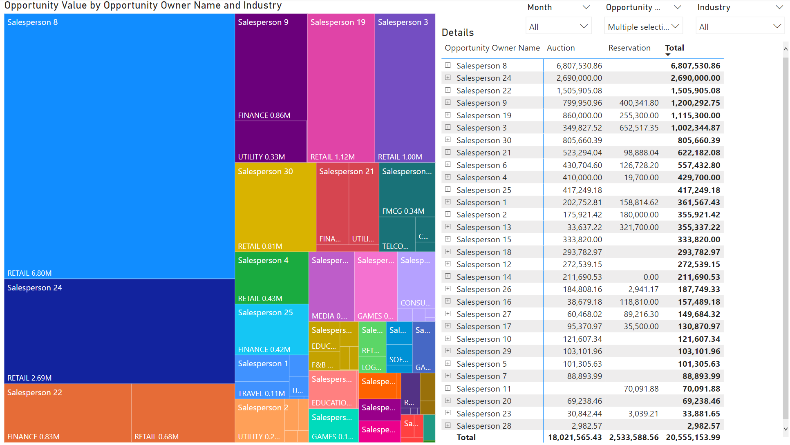
Sales Team Analysis
Top 6 salespersons based on opportunity values are 8,24,22,9,19 & 3.
All of their opportunities comes from Retail & Finance.
Salesperson 28 only has 3k sales.
Salespersons who have opportunities in 5 or more industries are: 1, 2, 6, 12, 18, 21.
There are some sales people with high opportunity values in reservations: 9,19,3,6,1,2,13,16, 27,11. Would be interesting to speak to them to find out why.

Slide 15
Things to Find Out
What caused Teams D2 & D to go beyond their opportunities? was it due to increase in sales effort? Or did the advertisers handled by D2 & D have underdefined opportunities?
The reason advertisers favor Auction ads instead of reservation.
Why some accounts/industries prefer reservation ads. (Is the reason due to not needing targeted reach?)
Why Team E has been slumping this bi-monthly.
What happened during August that caused revenue to drop.

Slide 16
Things Needed to Improve Analysis
If cost per serve is a KPI to track, income of each salesperson is needed.
With targets & revenue by account type & account name, we will be able to have a more detailed view of targets reached & opportunity value grasped.

Slide 17
Considerations for Next Bi-Monthly
Target industries that are willing to spend: Insurance, Automotive, Travel & Transportation. (Especially now that only 60% of users on tiktok are zoomers, which means the other 40 includes people like millennials and older with money.)
70% of our opportunity value lies in Retail and we see a large revenue spike in July. Thinking in today’s terms, it may be due to 7.7 sales. September and October are 9.9 & 10.10 respectively so our efforts can be targeted towards industries who can ride the shopping wave ie. Retail, Games, FMCG, Consumer, Sports, Fashion, Electronics.
There are many companies who are considered leads with 0 opportunity value, perhaps we can use the reason of 9.9/10.10 to reach out them.
Look into salespersons who are underperforming (ie. 28 & 23) and ask if they require any support to improve their sales.
Maybe group low performing salespersons with high performing ones within the same industry so they can learn from the best?

